Slide 1


High Intensity Beams Issues in the CERN Proton Synchrotron
S. Aumon EPFL-CERN

Slide 2
Contents
Context-Introduction
Transition Energy
Transition Studies
a. Fast Vertical Instability Measurements
b. Macro particles Simulations
c. Conclusions Transition Studies
Injection Studies
a. Loss experiments with BLMs
b. Turn by turn losses
c. Monte Carlo Simulation with Fluka
d. Coherent Tune Shift Measurements
e. Conclusions Injection Studies

Slide 3
Context-Introduction
Intensity increase limited by aperture restriction, collective effects (instabilities, space charge)
Here, studies of two intensity limitations on high intensity beams
- at injection (aperture restriction + space charge), more than 3% of the beam is lost, causing high radiation doses outside the ring
- at transition energy, fast vertical instability causing large losses or large transverse emittance blow up, even with gamma transition jump (good method to cure the instability).
Transition Studies
- Extensive measurements of the dynamics of the instability, with and without gamma transition jump.
- Benchmark of the measurements with macro-particle simulations with HEADTAIL.
- Deduce a effective impedance model (Estimate the real part of the broad-band impedance).
- Find possible cures.
Injection Studies
- Measurements of proton losses with Beam Loss Monitors (BLMs) to identify when the losses occur
- Losses when the beam goes through the injection septum (exactly at injection) AND then turn by turn at the minimum and maximum of the bump (orbit distortion at during 1/2ms)
- Space charge is making worth the losses.
- Tune shift measurements with intensity : deduce the imaginary part of the effective broad-band impedance.
Studies important in the framework of the PS Upgrade for LHC Injector Upgrade (High Luminosity LHC beam)

Slide 4
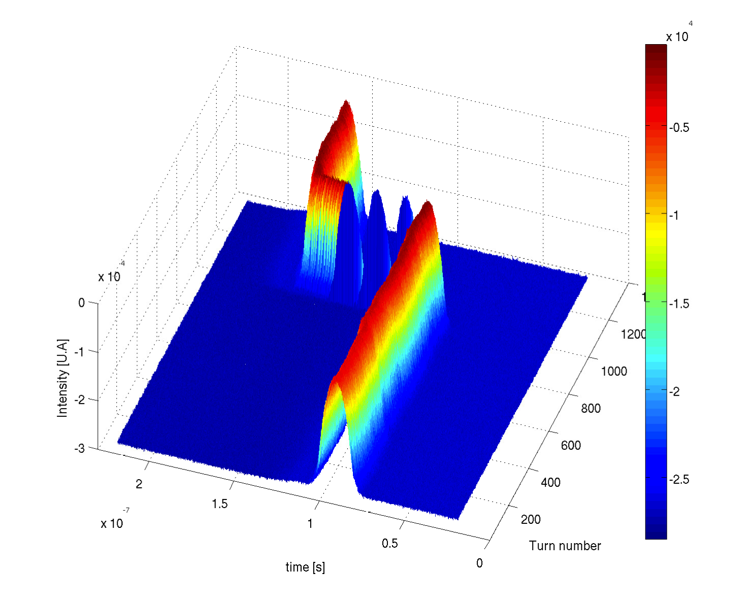
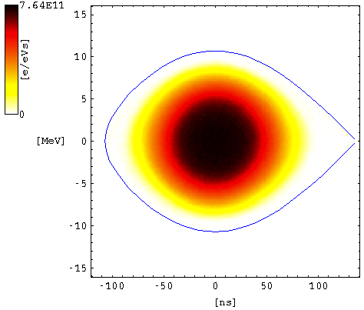
Transition Energy
Particle oscillate around (ΔΦ,δ) in the bucket, the equation of motion for small angle is the one of a spring. Particle oscillate with a angular synchrotron frequency ω_{s}
Close to transition energy, the longitudinal motion is frozen, ω_{s}→0, non-adiabatic regime
η defines the distance in energy from transition energy
Stable phase shift to keep the longitudinal focusing on both side of transition energy
In the PS, the use of a gamma transition jump is necessary to cross faster transition energy
Stable phase shift at transition
Tc non-adiabatic time~2.2ms
|t|>Tc adiabatic regime
|t|<Tc non-adiabatic regime
Particle are turning round in the RF bucket
Notes:
Eta unpert+gammajump
Particle in bucket

Slide 5
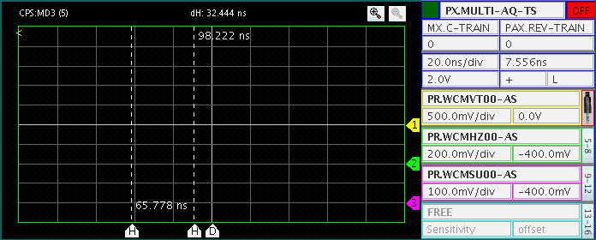

Fast Vertical Instability Observation
Vert. Delta signal
Hor. Delta signal
Longitudinal signal
A.U.
20ns
Instrumentation: Wide band pickup, bandwidth 1GHz
Travelling wave along the bunch with a frequency 700MHz.
Oscillation close to peak density, short range wake field.
Strong losses in few 100 turns, less than a synchrotron period.
Instability behavior similar to Beam Breakup (Linac), Transverse Microwave (coasting beam), TMCI (bunched beam)
Favorable conditions to develop the instability:
Slow synchrotron motion: no exchange of particles between head and tail stabilizing instabilities
No chromaticity: no tune spread.
Lose of longitudinal and transverse Landau damping
Loss of particles
Notes:
Ajouter AU et echelle de temps
Voir si je peux pas ajouter dans le film le saut de phase
Rendre le trait de l’intensite
Separer BB du reste

Slide 6
Goals of Measurements
Characterize the mechanisms of the instability by varying chromaticity, intensity, longitudinal emittance (ε_{l}) etc.
Study behavior of instability versus intensity to compute rise time
Measurement of intensity threshold
Momentum compaction factor threshold (η_{th}) to identify the longitudinal regime: adiabatic/non-adiabatic and define η_{th} as done for the longitudinal microwave instability ⁽¹⁾
First mechanism is the beam interaction with transverse impedance, for the PS, unknown, here assumed to be (BB) broad-band (resonator).
Find an effective transverse impedance model with the support of macro-particle simulations.
Identify mechanisms able to damp the instability: chromaticity, longitudinal emittance, use of the gamma jump
Defines BB model

Slide 7
Beam Conditions
Beam parameters
Transition Energy | ~ 6.1 GeV
Number of bunches | 1
Harmonic | h=8
Transverse tunes (Qx-Qy) | ~ 6.22-6.28 (Set by PFWs)
Vertical Chromaticity (2 different sets) around transition ξ_{y} | 0 and ~ -0.1 (Set by PFWs)
RF cavity voltage around transition | 145 kV
Full bunch length around transition | 20-30 ns
Longitudinal emittance (ε_{l}) at 2σ⁽¹⁾ | 1.3 -2.5 eVs
Beam intensity | 50e10 to 160e10 protons
Transverse Emittance (ε^{x,y}_{norm} 1σ) | 1.17 to 2.33 mm.mrad
Accelerating bucket
δE
δz
Reconstruction of the longitudinal phase space for longitudinal emittance measurements
⁽¹⁾ Measured at the beginning of the acceleration
Notes:
Comprimer le slide en deux et mettre que le tomoscope
Remettre pfw pourt tune
Faire un slide de reserve sur pfws
Transverse emittance

Slide 8
Rise time
Chromaticity measurements not reliable around transition
linear/saturated
non-linear
Tc: non-adiabatic time 2.2ms in the PS
Rise time measurements performed for different longitudinal emittance and for 2 different sets in vertical chromaticity.
Closer the beam is from transition energy, less reliable is the measurement of the chromaticity
Weak reproducibility of the machine in terms of longitudinal emittance (20%)
Surprisingly, rise time faster in linear part for the case with chromaticity.
Notes:
Growth rate plot en reerve

Slide 9
Threshold in Intensity
Instability with threshold in intensity
I_{th} increases linearly with the longitudinal emittance (here peak density), predicted by the coasting beam theory by E. Metral for zero chromaticity
Chromaticity (or the working point) increases the instability threshold: changing chromaticity in the PS means a change of tune and non linear chromaticity
Non-linear chromaticity components in measurements are nevertheless small
Rise time are faster than synchrotron period
(no headtail instability)
According to the coasting theory (microwave-TMCI), a beam crossing transition is always unstable, because η→ 0
Curves constant
once normalized by the longitudinal emittance
Minimum due to synchrotron period Ts
Notes:
Reproductibility de la machine pour barre erreur
Arranger le carre “Curve”

Slide 10
Eta threshold
Error bar contains the possible error on the transition timing
Instability is triggered at different η, namely η_{th} for each intensity.
η_{th} linear with beam intensity.
Minimum η_{th} :
- Meas. 0.0004 , zero chromaticity
- Meas. 0.001, negative chromaticity
Resulting η is right only if the estimation of transition time is good.
With chromaticity, possibility to accelerate more intensity for the same η_{th}
Offset

Slide 11
Threshold in Intensity with gamma jump
η_{th}~0.005
Use of a gamma jump allows to increase considerably I_{th}
Instability appears around η_{th}~0.005
Frozen synchrotron motion for a shorter time allows to increase by a factor 3 and up to 10, I_{th} according to the working point.
Negative large chromaticity before and positive chromaticity after transition helps to increase intensity threshold.
Threshold in η are also increased by a factor 10.
Notes:
Ajouter ou apparait l’instabilite
Frozen synchrotron motion for a shorter time

Slide 12
Conclusions of Experiments
First time that extensive measurements are done for this instability: instability measurements for zero and small negative vertical chromaticity varying the longitudinal emittance (peak density) and the beam intensity.
Instability is easily developed for zero (small) chromaticity (not a head-tail kind) and for slow synchrotron motion (BBU or coasting beam), and high peak density (coasting beam).
Chromaticity is a way to increase threshold in intensity and in η.
Increase synchrotron motion (η) with the gamma jump, here close to a factor 10 with a good set in working point.
η_{th} ≠0 for the set zero-chromaticity, could be due to an error in estimation of the transition time (~300 turns is definitively possible), need to be check with macro-particle simulations.
It appears that fast synchrotron motion (large η) + jump in chromaticity from large negative value to large positive value is a way to cure the instability.
Need of macro-particle simulations to benchmark the measurements and understand better the dynamics of the instability.
- Check the ratio
- threshold in η and in intensity.
- Possibility to have a predictive model

Slide 13
Macro-particle Simulations (HEADTAIL)
Use of a transverse broad-band impedance model (resonator)
I modified the code to adapt it as close as possible as the measurement conditions
Useful outputs to consider through transition
Turn by turn Δ_{y} signal
Vertical normalized emittance
Vertical centroid
ω angular revolution frequency
ωr resonator frequency
Rs shunt impedance (MΩ/m)
Q quality factor
Simulation parameters
RF bucket | accelerating
Momentum rate | 46 GeV/c/s
Twiss <βx,y> | 16/16 m
Qx,y | 6.22/6.28
Gamma transition | ~ 6.1
Vacuum chamber | flat
Impedance model | broad-band
Quality factor Q | 1
Resonator frequency | 1 GHz
Shunt impedance Rs | To be matched

Slide 14
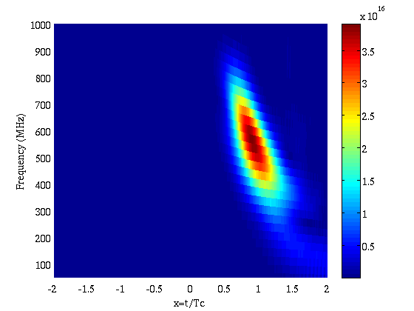
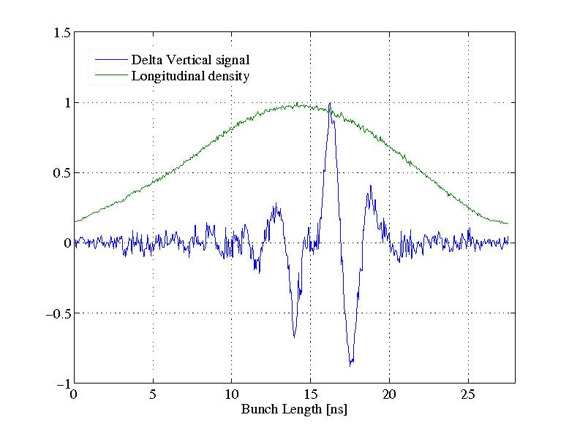
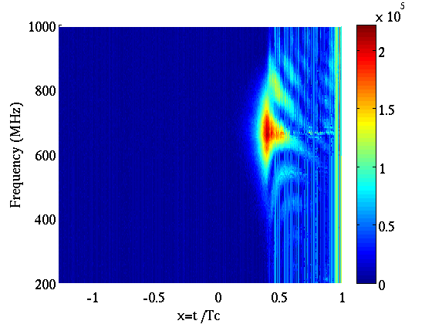
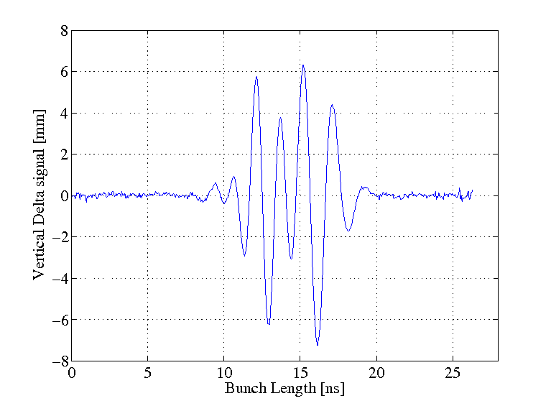
Simulation with HEADTAIL
ξv =0
HEADTAIL
Instability at η_{th}
Oscillation Starts at the maximum peak density as the measurements
HEADTAIL
Measurement
Tc: nonadiabatic time ~2.2ms
Measurements
HEADTAIL, Instability well above η_{th}
Notes:
Plot mesures
Axes sont pas les memes

Slide 15
Simulated Rise time
fr=1GHz
Rs=0.7MΩ/m
Q=1
1.9 eVs
2.3 eVs
1.5 eVs
Measurements
Simulations

Slide 16
Dynamics with chromaticity
Implementation in the code of a chromaticity change with acceleration
Delta vertical signal shows that the oscillation of the instability is dumped with chromaticity compared to the same profile with the same energy with zero chromaticity.
Not the same dumping at the intensity threshold as in the measurements for the same chromaticity .
Effective impedance between 0.5 and 0.7 MOhm/m

Slide 17
Threshold in Eta
No Chromaticity
Small Negative Chromaticity
≠ η_{th}
Not Same Scale
≠ η_{th}
Offset
Agreement with measurements:
η_{th} increases with chromaticity, allows to accelerate more intensity with non zero ξ_{y}
Offset between η_{th}(ξ_{y}=0) and η_{th}(ξ_{y}<0)
Linear behavior eta th with intensity
Best impedance model found
Rs=0.7MΩ/m
Q=1, short range wake field
Fr=1GHz
Disagreement with measurement and simulations:
Not the same η_{th} close to the intensity threshold
Not the same linear behavior about the slope
Offset in η of 0.0002 in simulations , 0.0006 in measurements
Notes:
Eta th ajouter dans le plot
Ajouter theory

Slide 18
Conclusions
Conclusions of the study
- Equivalent broad-band impedance found Rs=0.7MΩ/m, fr=1GHz, Q=1
- Intensity threshold predictable at 50%
- Possible cure of the instability: adequate chromaticity (working point) + gamma jump.
Limitations
- Impedance model is the biggest unknown of the study.
- I_{linear}/I_{th} ~ 1.3-1.5 (Measurements) versus I_{linear}/I_{th} ~ 3-5 (HEADTAIL)
- η_{th} close to the threshold in intensity are very different, partly explained the setting of the transition timing in measurements.
- Different offset in η_{th ,} but behavior comparable to coasting beam theory
- The effect of chromaticity is less important in the simulations than in the measurements (strong effect !)
- Not presented here, but the simulations with gamma jump show travelling wave frequency higher than in the measurements.
- Influence of space charge not included in simulations.
- Non-linearities generated by PFWs.
- linear and non-linear coupling not included in simulations.
Outlooks – Future works
- Complete impedance model
- Studies of Chromaticity jump
- Collaboration with GSI: similar studies are carried out at GSI and measurements at the CERN PSBooster and PS will be made in June.
- Octupoles

Slide 19
Studies of losses at Injection
Facts
Large losses of proton while the beam is injected into the PS.
Strongly dependent of the beam intensity, therefore high intensity beams most concerned
(ToF, CNGS), at least 3-4% of losses.
High radiation dose outside the ring (the so-called Route Goward)
Later motivation, injection energy upgrade from 1.4 to 2 GeV kinetic, the radiation dose will be increased by a factor ? ⁽¹⁾ with the same scenario of losses.
Aims: find the mechanisms of the protons beam losses.
Beam intensity continuously increases since its commissioning
⁽¹⁾ Work of S. Damjanovic

Slide 20
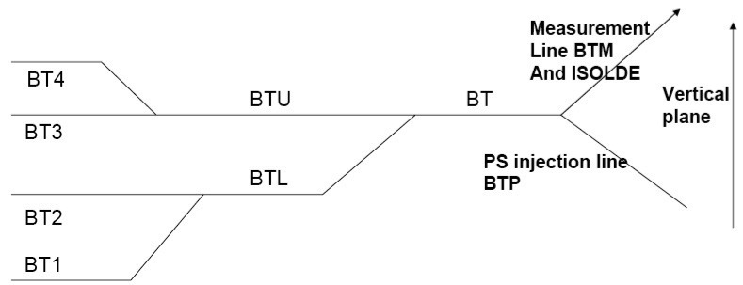
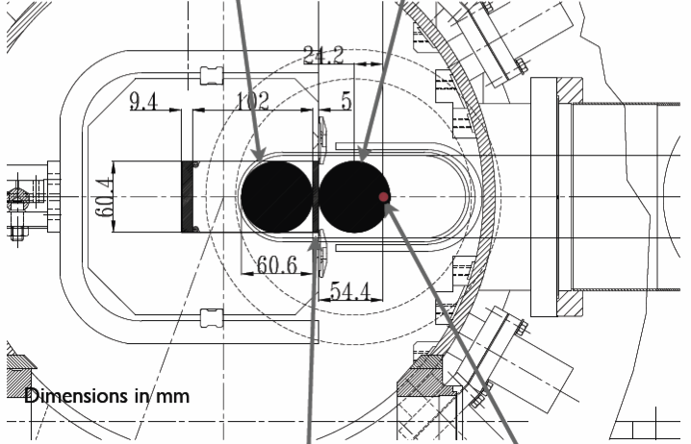
Single Turn Injection System
Booster
4 superposed rings
Possible optics mismatch?
Cross Section Injection Septum
Injection bump
Aperture restriction?

Slide 21
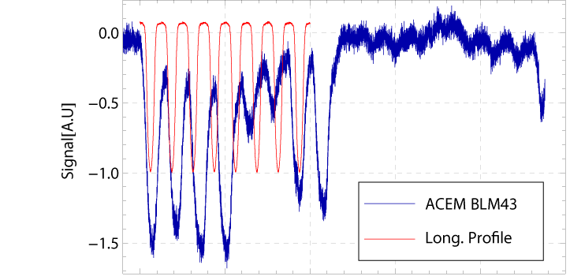
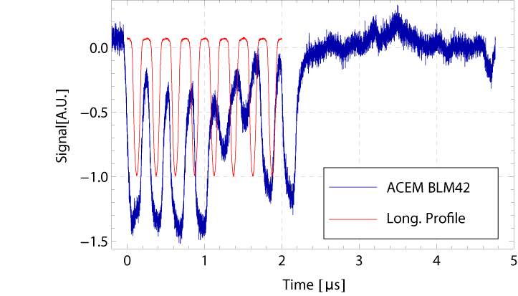
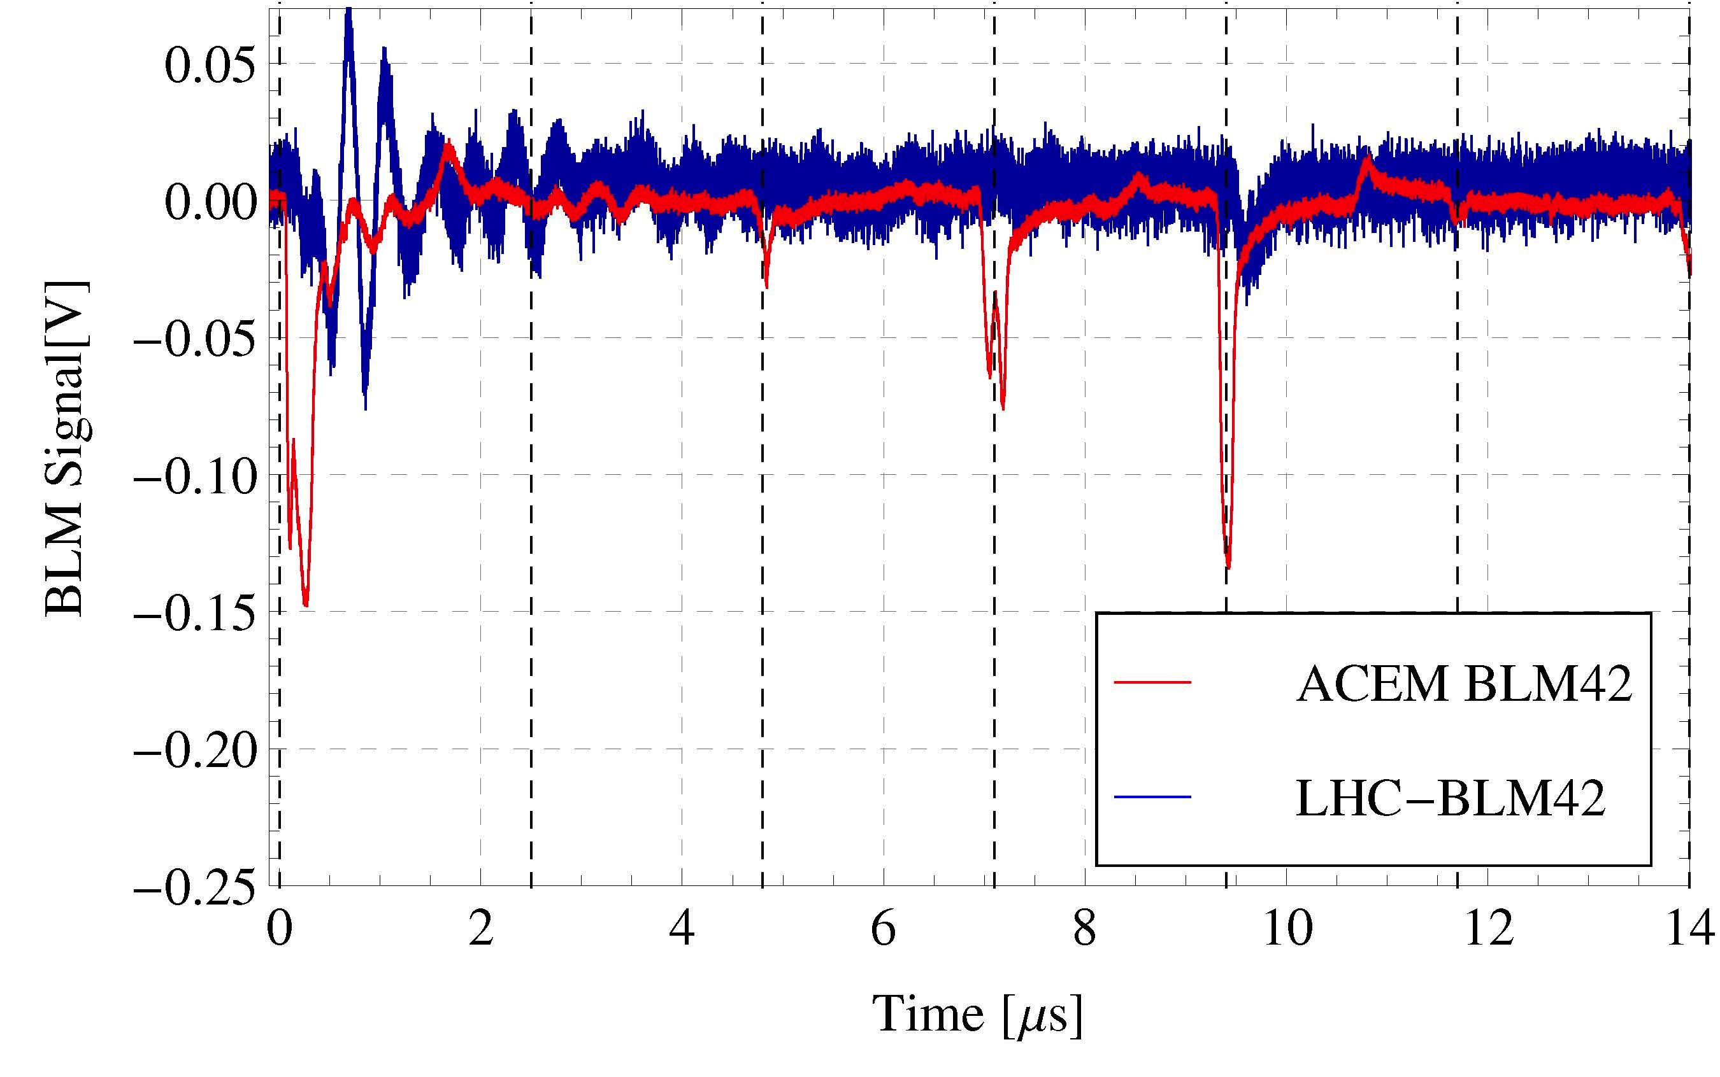
Loss Experiments
Injection, transit through the septum
BLMs located at the maximum (SS42) and minimum (SS43) of the bump, i.e. where the available aperture is minimum.
Measurements done while the beam is injected (first turn) on single bunch ToF and multi-bunch CNGS beam.
Losses while the beam is going through the injection septum, the beam is injected at the maximum of the bump.
The BLM are able to distinguish the losses bunch to bunch.
Conclusions:
Losses occur while the beam is going through the septum and then turn by turn
BLM at minimum of the bump
1 turn
Beam composed by 8 bunches
BLM at maximum of the bump
Beam from
Ring 2
1turn
2turn
3turn

Slide 22
Septum losses
Betatron and dispersion matching measurements in order to identify a possible mismatch between the injection line and the PS: determination of initial conditions, in particular for the horizontal dispersion.
Good agreement with the optics model computed with PTC-MADX:
- No large mismatch was found expect on dispersion for Ring 3.
- Beam size measurements right at injection: tail of the beam are cut on the septum blade (~1%)
It was found that the beam is pushed as close as possible of the septum blade to decrease the angle given to the beam by the injection kicker: compromise between losses and kicker strength.

Slide 23
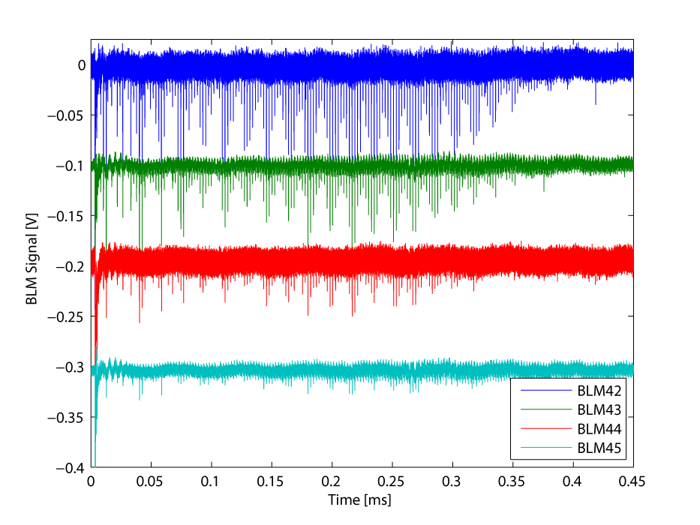
Turn by Turn losses
Turn by turn losses while the injection bump is decreasing.
The losses occurs at the maximum and at the minimum of the bump: tails of the horizontal distribution are cut around 3 sigma.
Presence of direct space charge at injection
Preliminary tune footprint simulation with PTC-Orbit show the possibility that particles cross the integer resonance
It can cause emittance blow up and high amplitude oscillation which hit the vacuum chamber at the first aperture restriction
Artificial offset to distinguish the different signal
Integer tune

Slide 24
Fluka Simulations
Goal: Reproduce the signal of the BLM at injection (Supervision of a student)

Slide 25
Coherent tune shift measurements
Motivation
Impedance effects (wall, space charge) are important issues at injection
First step toward a more complete PS impedance model
Instability rise time measurements
(Transition study)
Real Tune shift measurements
Estimation of this part
HI-LHC

Slide 26
Coherent tune shift at injection
Kinetic energy 1.4GeV
Tune measurements all along the energy plateau
Notes:
Enlever la table et mettre certaines infos de l table dans les slides, garder bl and el

Slide 27
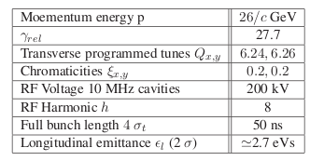
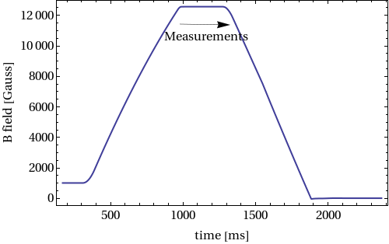
Beam parameters at LHC extraction energy
Almost no coherent tune shift in the horizontal plane.

Slide 28
Effective Impedance
From the measured tune shift with intensity, the effective impedance can be deduced from the Sacherer formula of the interaction of the bunch spectrum in frequency with a broad-band impedance:
Zeff
(1)
Important Conclusions
Zeff depends of bunch length
Kinetic Energy K | 1.4 GeV
Bunch length | ~ 180 ns
β_{rel} | 0.91
γ_{rel} | 2.47
ω₀ | 2728 e3 rad.s-1
Horizontal Z_{eff} | 3.5 MΩ/m
Vertical Z_{eff} | 12.5 MΩ/m
Momentum p | 26GeV/c
Bunch length | ~ 50 ns
β_{rel} | 0.9993
γ_{rel} | 27.729
ω₀ | 2996 e3 rad.s-1
Horizontal Z_{eff} | < 1 MΩ/m
Vertical Z_{eff} | 6.1 MΩ/m
Increase by a factor 2 with respect to measurements done in 1990 and 2000
⁽¹⁾ From Sacherer formula (CERN/PS/BR 76-21)
Notes:
Ajouter du texte

Slide 29
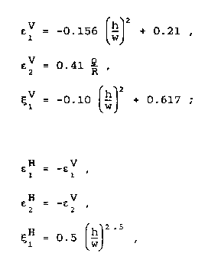
Space Charge Tune Shift Estimation
“Non penetrating field”
Laslett coefficients for elliptical chamber
a centered beam in the vacuum chamber
valid for h/w < 0.7
(B. Zotter CERN ISR-TH/72-8)
Estimation:
ΔQ-Space charge ~ ¼ Total measured ΔQ at injection. Space charge for beam used for measurement
29
Notes:
Reecrire le cadre et mettre plus de texte

Slide 30
Conclusions Injection Studies
Large beam losses were measured on high intensity beams (more than 3%), which induce also high radiation outside of the ring. The goal of this study was to identify the loss process, limited an intensity increase.
BLM experiments measuring the proton losses while the beam is going through the injection septum+ matching measurements:
- combination of large beam size for high intensity beam, aperture restriction.
- the beam is placed close to the septum blade to save some strength of the injection kicker.
- tails of transverse distribution are cut at least at 3 sigma, explaining 1-2% of losses.
Turn by turn losses while the injection bump is decreasing: measured losses at the maximum and minimum of the bump (minimum of available aperture).
Direct space charge repopulated the transverse phase space extending the duration of the losses.
Tune shift measurements with intensity in order to evaluate the imaginary part of the impedance and estimate the Laslett tune shift due to space charge (about ¼ of the total tune shift)
Possible cures
- For space charge: increasing the injection energy to 2GeV is a gain of 63% in the tune spread (PS-LIU Project)
- 2GeV injection energy is a gain in beam size due the shrinking of the transverse emittance.
- New optics in the transfer line to make a small beam size at the injection point in both x,y planes-(2 different optics for LHC and for high intensity beams)
- The PS optics has to adapted (QKE optics) to avoid optical mismatch
- Impedance model also needed to predict instabilities at injection, mostly head-tail kind

Slide 31
Appendix 1

Slide 32
Appendix 2: Beam Conditions

Slide 33
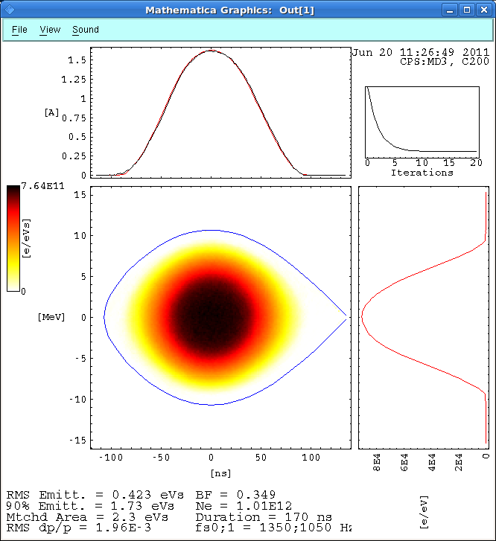
Appendix 2: Beam Conditions

Slide 34
Growth Rate

Slide 35
Adaptation of the code
Almost adiabatic decrease of RF Voltage
Changed in chromaticity.
HEADTAIL already simulates acceleration (G. Rumolo, B. Salvant)
No longitudinal and transverse space charge
Higher order momentum compaction factor neglected (cancellation at transition)
No coupling

