Slide 1
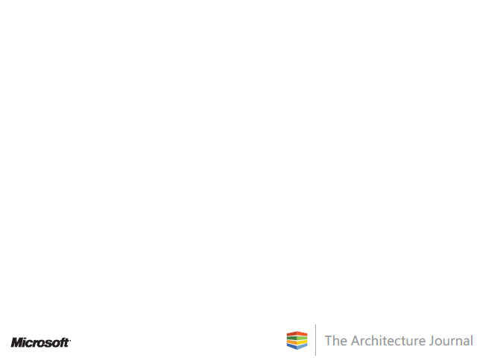
SEAM
A Family of Methods for
Business and IT Co-evolution
Alain Wegmann
Professor
Ecole Polytechnique Fédérale de Lausanne (EPFL)
Notes:
Presentation of SEAM by Prof. Alain Wegmann. SEAM is a family of methods to analyze and design business and IT co-evolution.
Alain Wegmann (alain.wegmann@epfl,ch) is professor at the “Ecole Polytechnique Fédérale de Lausanne” (http:///www.epfl.ch). He worked 14 years in the industry in engineering (Switzerland, Taiwan, US), manufacturing (Taiwan) and industrial marketing (US). Since 1997, he and the members of his research group develop methods for business and IT co-evolution (or alignment) (http://lams.epfl.ch). These methods are now used in teaching and consulting.
AW 20100307, SEAM is © EPFL 2000 - 2010

Slide 2
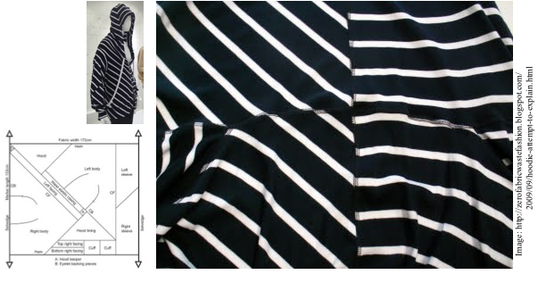
SEAM
« Systemic Enterprise Architecture Methodology »
© TIMO RISSANEN, zerofabricwastefashion.blogspot.com
Notes:
SEAM stands for “Systemic Enterprise Architecture Methodology”.
However, we prefer to interpret SEAM as the joining between two pieces of cloth. We believe this reflects well the dynamic nature of business and IT co-evolution. Business drives IT and IT drives business. SEAM is a communication tool used in workshop that includes business and IT people. Together, they can shape this co-evolution.
We illustrate SEAM with an interactive example shown in the video associated to this presentation. In this (fictitious) example, we model Amazon selling new books (as-is) and what should change to sell new and used books (to-be).

Slide 3
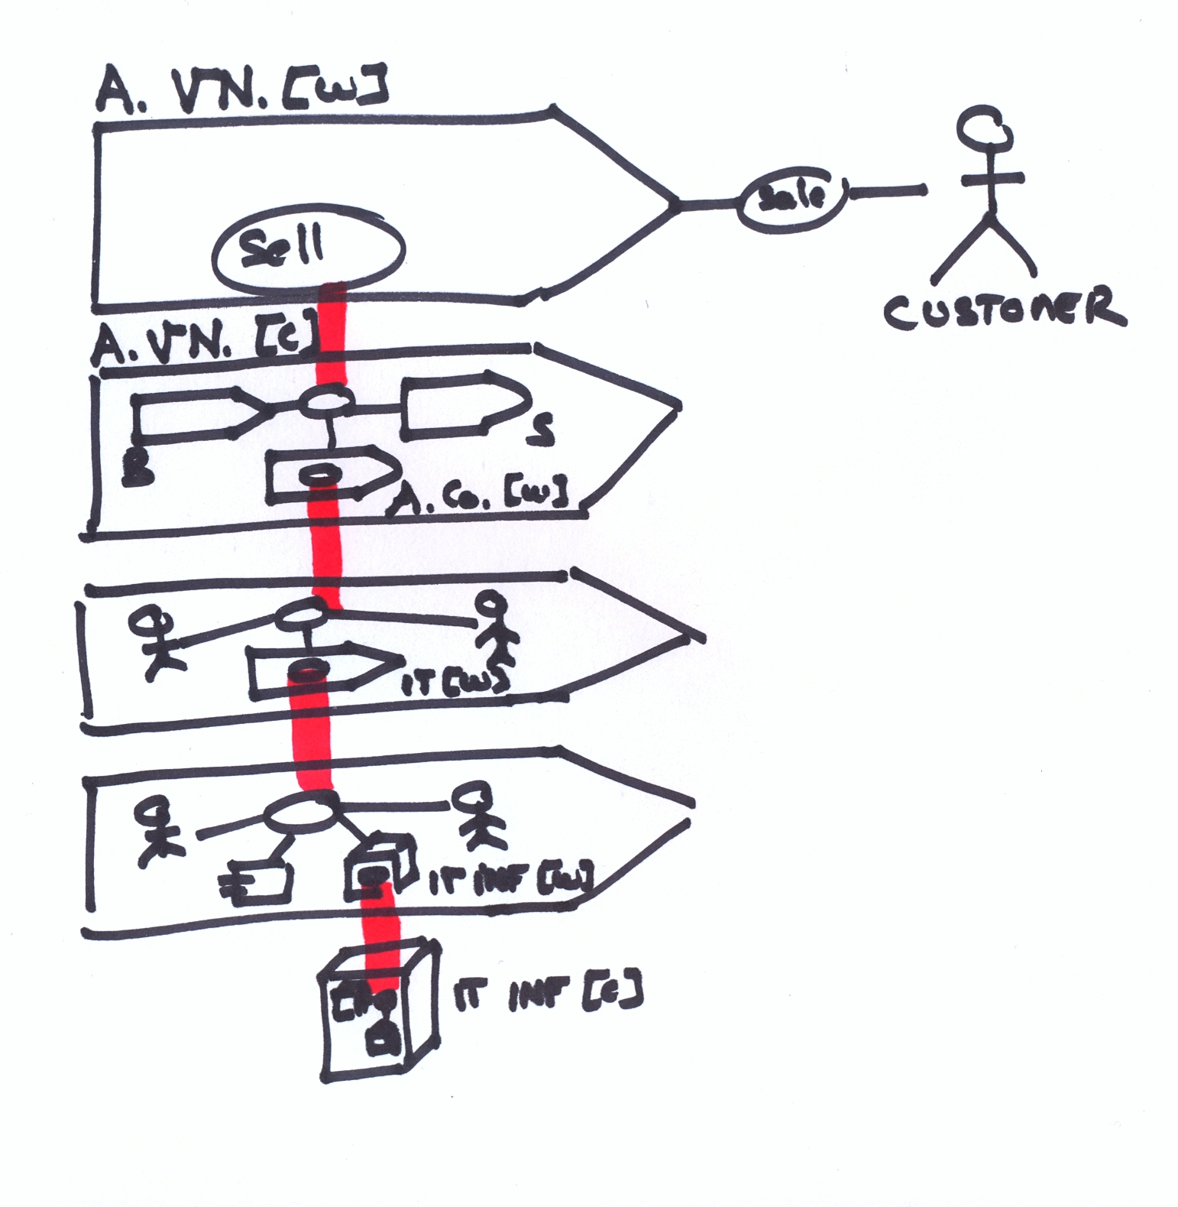
SEAM Example (as-is)
Live example –
see video.
Notes:
First we make a model as-is. This model is over-simplified to fit in the 2min time slot. In a real workshop, we would develop such model in an hour or so.
The model represents a hierarchy of systems:
Amazon Value Network as a whole (or black box) that provides the service “Sell” to the Customer. This model is useful to understand the overall customer experience.
Amazon Value Network as a composite (white box) that makes explicit the intercompany process and which companies work together to provide this service. We can then understand the service offered by Amazon Company as a whole (black box) to its partner companies.
Amazon Company as composite (white box) that makes explicit the business process and which employee work together to provide the service offered by the company. We also represent the service offered by the IT Department as a whole (black box).
IT Department as a composite (white box) that makes explicit the IT processes. We can also represent the IT applications and the IT infrastructure as a whole (black box).
last, we represent the IT infrastructure as a composite (white box) and we can analyze which components are part of the infrastructure.
With such analysis, it is possible to represent a business view (upper levels) and an IT view (lower levels) for a project. This is very useful to get business and IT people to agree on the responsibilities of each group.

Slide 4
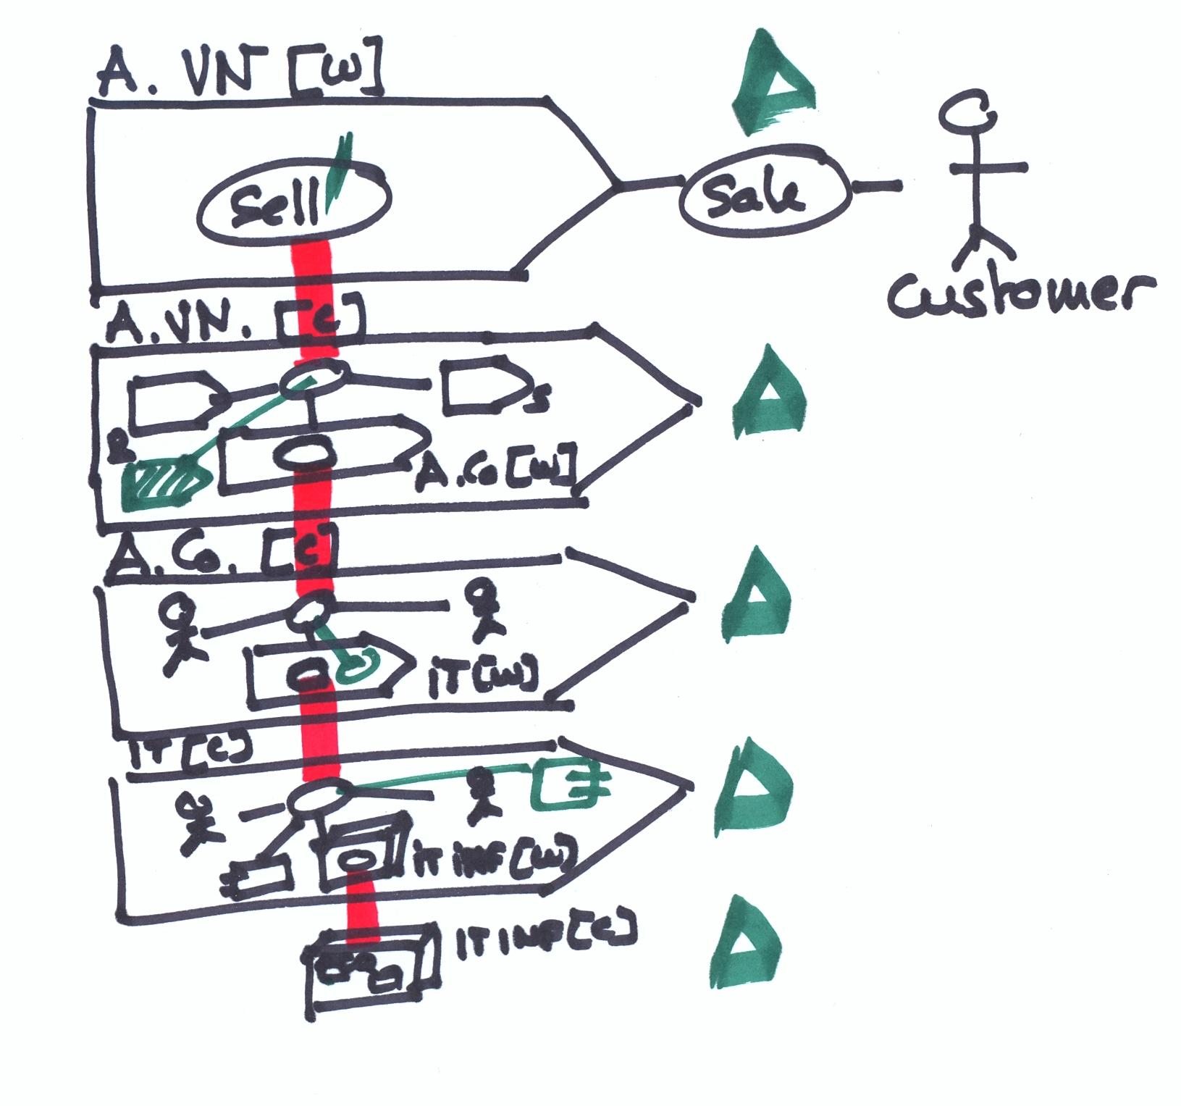
SEAM Example (to-be)
Live example –
see video.
Notes:
Then a model “to-be” can be developed. We can represent what changes at each level:
A new service “ Sell’ “ is offered. This service provides new and used books.
New partner companies are added to the value network (typically, the used books providers).
New services are offered by Amazon IT Department. For example, the service necessary to coordinate all used books sellers.
New IT applications might be needed.
The infrastructure needs to be adapted (more capacity, security, etc…).
Once all these aspects are identified a multi-level cost / benefit analysis can be done (delta signs in above image).
---
In summary, with an approach as SEAM, it is possible, in a day or two, to develop a good shared understanding of a project scope, impact and costs/benefits. Then traditional methods can be used to manage the project. SEAM is mostly used in early requirements to get business and IT people to share a common vision.

Slide 5
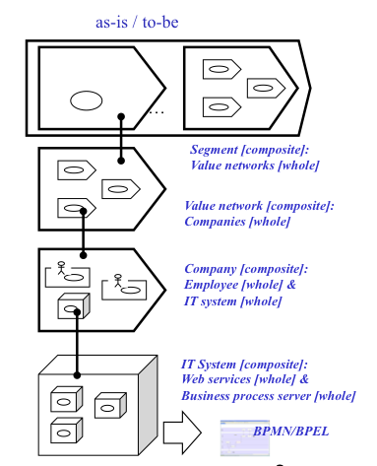
SEAM Principles
Systemic
(hierarchical complex systems, networked organizations)
Concrete
(project-based, name of people and organization, examples, …)
Rigorous (discrete simulation, system dynamics, logic)
Subject-based (viewpoints, goals)
Notes:
SEAM is based on the four principles listed above.
Systemic principle: with SEAM, we model systems. We consider that systems are a useful tool to analyze a situation. The way systems are used in SEAM does not imply that the world is hierarchical. Only our understanding of the world is facilitated by a hierarchical vision. In SEAM, we can also model networks (by having the same organizations in multiple systems).
Concrete principle: with SEAM, we model only concrete situations. We represent real people (frequently with real names and pictures). We analyze concrete projects. This helps business and IT people to identify themselves with the model.
Rigorous principle: with SEAM, we can make executable models. We can add information to the model to a point that we can execute them. We have different kinds of execution modes: discrete simulation (like program execution), quantitative simulation using system dynamics (to see trends), logic (to check for incompleteness or contradictions).
Subject-based principle: with SEAM, we make model using viewpoints (we focus on one company, we represent different levels that correspond to different disciplines). We can also analyze motivations of people.

Slide 6
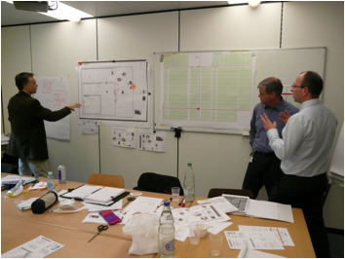
SEAM Process
Notes:
SEAM is used mostly in workshops. In this picture, an ITIL Service Level Management workshop run in collaboration with the company Itecor (www.itecor.com/). We analyze the hierarchy of systems (left poster) and the service offered by the IT department (right poster). This is done for a concrete project, related to power distribution, in a utility company.

Slide 7

SEAM Family of Methods
SEAM for Strategic Thinking
SEAM for Industrial Marketing
SEAM for Enterprise Architecture
SEAM for Requirements Engineering
SEAM for Service Level Management
SEAM for IT Architecture...
Notes:
SEAM exists in multiple versions. The idea behind these versions is always the same. We take the best practices from a discipline/field and we integrate them in SEAM.
For example, SEAM for Industrial Marketing can be considered as the best practices used in industrial marketing (e.g. Porter analysis, SWOT analysis, technology sale process, etc…) interpreted using SEAM models. With this, it is it possible to leverage on the best practices while benefiting of the power of a SEAM workshop. This reduces also the SEAM learning curve.
The methods we develop address marketing (SEAM for Strategic Thinking, Industrial Marketing), business and IT co-evolution (SEAM for Enterprise Architecture, SEAM for Requirements Engineering) and IT management (SEAM for Service Level Management, SEAM for IT architecture). SEAM for Service Level Management is co-developed with the company Itecor (www.itecor.com/)

Slide 8
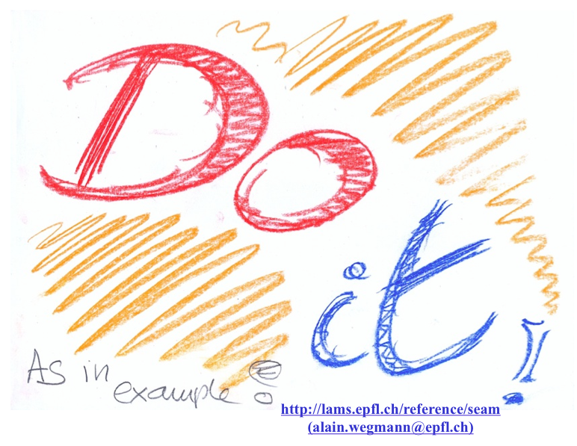
Notes:
Our final recommendation is that you try to use the method as shown in this presentation (and associated video). It is easier than expected and helps a lot to make business and IT people communicating together.
For more information, you can contact:
alain.wegmann@epfl,ch
You can also check our website:
http://lams.epfl.ch/reference/seam

Slide 9
Credits
Gil Regev – (overall SEAM, system thinking)
Andrey Naumenko – Phd 2002 – RM-ODP
Gil Regev – Phd 2003 – goal modeling
Otto Preiss – Phd 2004 – quality modeling
Pavel Balabko – Phd 2005 – role modeling
José Diego de la Cruz – Phd 2007 – declarative semantics
Irina Rychkova – Phd 2008 – operational semantics
Lam-Son Lê – Phd 2008 – system modeling
Arash Golnam – Phd – system dynamics (2009 - …)
Anshuman Saxena – Phd – value modeling (2009 - …)
Julien Ramboz – Phd – tools & methods (2010 - …)
Our industrial and academics partners
Georges-A. Garret | Olivier Hayard | Olivier Perroud
Frédéric Bouchet | Guy Genilloud | Don Gause
Viktor Kuncak
Notes:
SEAM is developed in a research laboratory. The main contributors are the PhD students who make their PhD on SEAM.
We also work closely with industrial and academic partners that provide use case studies and the theoretical foundations of SEAM. The main contributors are listed above.

Slide 10
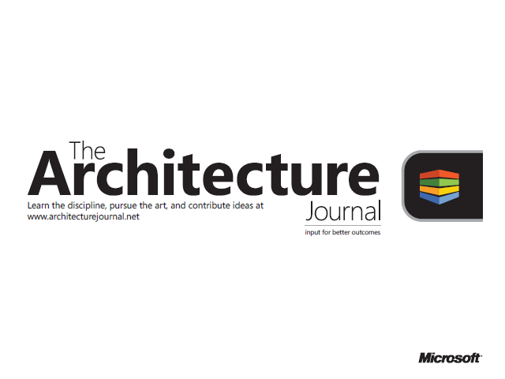
© 2009 Microsoft Corporation. All rights reserved. Microsoft, Windows, Windows Vista and other product names are or may be registered trademarks and/or trademarks in the U.S. and/or other countries.
The information herein is for informational purposes only and represents the current view of Microsoft Corporation as of the date of this presentation. Because Microsoft must respond to changing market conditions,
it should not be interpreted to be a commitment on the part of Microsoft, and Microsoft cannot guarantee the accuracy of any information provided after the date of this presentation.
MICROSOFT MAKES NO WARRANTIES, EXPRESS, IMPLIED OR STATUTORY, AS TO THE INFORMATION IN THIS PRESENTATION.

